Slide 1
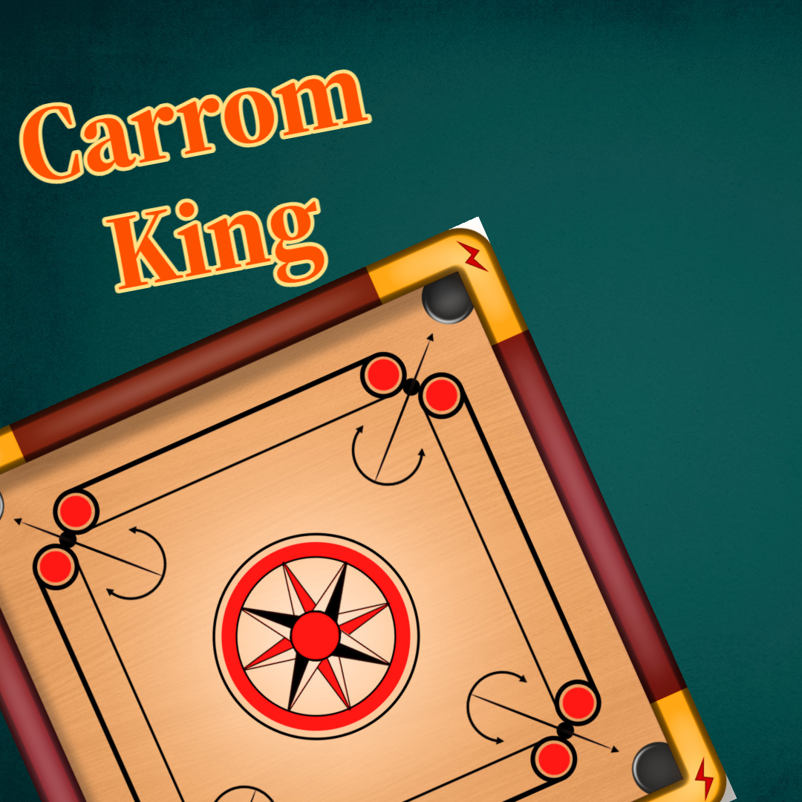




CARROM KING
Creators:
Prabesh Bashyal
Pratik Adhikari
Rishikesh Paudel
Creators:

Slide 2
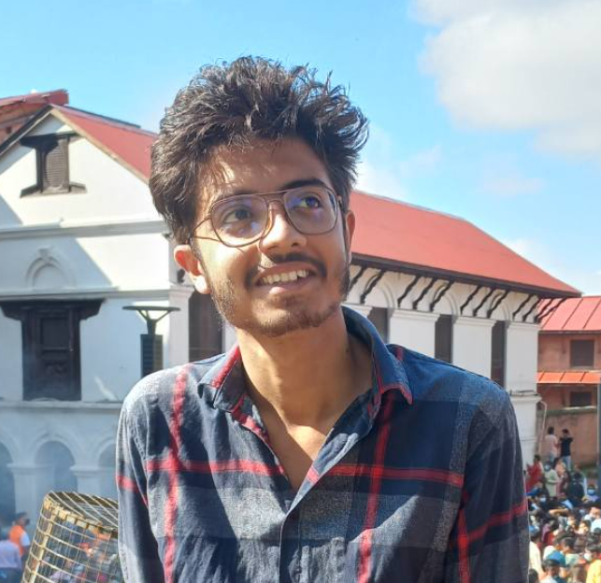



THE TEAM
Prabesh Bashyal
078BCT057
Pratik Adhikari
078BCT062
Rishikesh Paudel
078BCT064

Slide 3

OBJECTIVES OF THIS PROJECT

Slide 4
OBJECTIVES OF THIS PROJECT
Understanding Object-Oriented Programming (OOP)
Utilizing Objects in C++
Code Reusability
Header Importing
Enhancing Programming Skills
Learning Software Development Processes
Collaboration and Teamwork
Exploring Game Mechanics
Experiencing Visual Programming

Slide 5
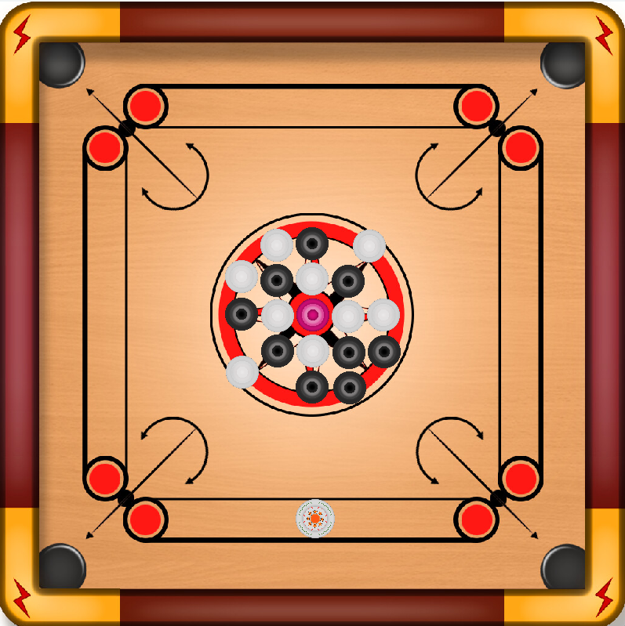
INTRODUCTION

Slide 6
INTRODUCTION
Origin: Traced back to the Indian subcontinent, popular worldwide.
Setup: Played on a square wooden board with pockets at each corner.
Objective: To pocket the game pieces using the striker, earning points.
Players: Usually played by 2 to 4 players, in singles or doubles.
Gameplay: Involves skillful flicking of the striker to hit game pieces into pockets.

Slide 7

METHODOLOGY

Slide 8

METHODOLOGY
Planning and Gathering Information
System Model and Design
Software Development
Testing and Implementation

Slide 9

LITERATURE SURVEY

Slide 10
LITERATURE SURVEY
Introduction
Previous Implementation
SDL Library Overview
Game Development Basics
Physics Simulation
User Interface Design
Graphics and Animation
Sound Effects
Challenges and Consideration
Conclusion

Slide 11
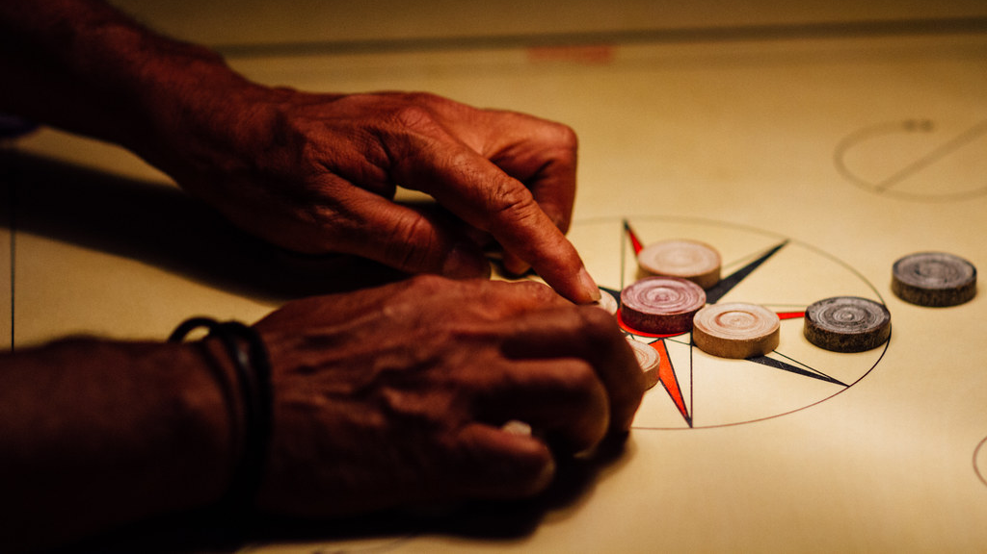
GAME IMPLEMENTATION

Slide 12
GAME IMPLEMENTATION
Setup
Render the Carrom Board
Input Handling
Physics Simulation
Collision Detection
Game Logic
Player Turns
Scoring and UIs
Sound Effects
Game Conditions
Graphics and Animation
Cleanup and Exit

Slide 13


Slide 14

PROBLEMS FACED

Slide 15
PROBLEMS FACED
SDL Linking Problem
Game Mechanics
Collision Physics
Template Linking Problem
Networking Problem
Bugs and Glitches

Slide 16

SOLUTIONS

Slide 17
SOLUTIONS
SDL Linking Problem
This problem was solved by including the include and library files in the right place.
Game Mechanics:
This problem was solved by dividing the problem into smaller manageable chunks.
Collision Physics
This problem was solved by using proper collision physics algorithm.

Slide 18
SOLUTIONS
Template Linking Problem
This problem was solved removing the template and using required data types.
Networking Problem
This problem will be resolved in the next version of the game.
Bugs and Glitches
They were solved by identifying the bugs using debugging tricks.

Slide 19

LIMITATIONS

Slide 20
LIMITATIONS
Carrom Physics isn’t as smooth as expected.
Individual codes of developers weren’t integrated smoothly.
LAN features weren’t implemented due to knowledge and time constraints.

Slide 21

FUTURE ENHANCEMENTS

Slide 22
FUTURE ENHANCEMENTS
Improved Game Mechanics
Smoother Collisions
Implementation of Advanced Rules, Fouls and Penalties
Optimized Code
Upgraded Graphics
More Modes

Slide 23

CONCLUSIONS
This Photo by Unknown Author is licensed under CC BY-NC

Slide 24
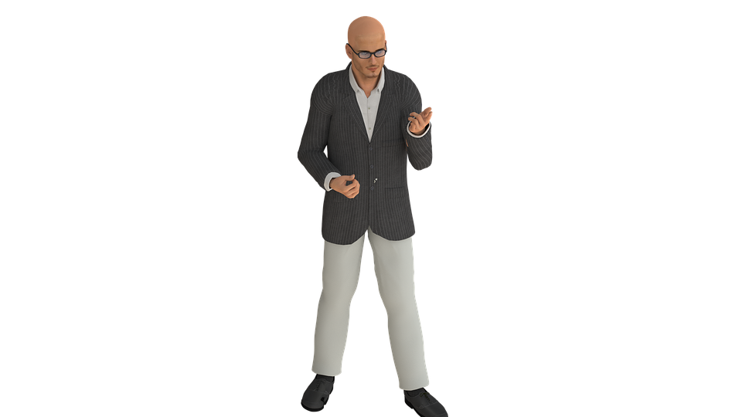
CONCLUSIONS
By making this project, we learnt:
Object Oriented Programming
Fundamentals of C++ Programming
Functions in C++
Class and Objects
Constructors and Destructors

Slide 25
CONCLUSIONS
By making this project, we learnt:
Operator Overloading
Inheritance
Virtual Functions and Polymorphism
Templates
Namespace
Exception Handling (For Debugging)

Slide 26

RECOMMENDATIONS

Slide 27
RECOMMENDATIONS
Organize your codebase into well-defined classes and functions.
Optimize critical parts of the game loop for smoother gameplay.
Design an intuitive and user-friendly interface for easy navigation.
Implement proper error handling to gracefully handle unexpected situations.

Slide 28
RECOMMENDATIONS
Thoroughly test the game for different scenarios and edge cases.
Ensure your game runs smoothly on different operating systems.
Implement proper memory management practices to avoid memory leaks.
Keep backups of your codebase and important assets to prevent data loss.

Slide 29


THANK YOU!
Mr. Daya Sagar Baral
Faculty Member at DOECE
Director at CIT
We express deep appreciation to Mr. Daya Sagar Baral sir for expertly guiding us in mastering C++.

Slide 30


ANY QUERIES

Slide 31
Timeline:
Research and Selection
Step 1
Planning
Step 2
Production
Step 3
Debugging
Step 4
Deployment
Final Step

